Slide 1
Digital Portfolio
STUDENT NAME: KAMAKSHI.R
REGISTER NO: 212403616
NMID: 1A080B71C108B169CF540FD67B572
DEPARTMENT: BCA
COLLEGE: MAHALASHMI WOMENS COLLEGE OF ARTS AND SCIENCE
UNIVERSITY: MADRAS UNIVERSITY

Slide 2
PROJECT TITLE
This project is a Student Portfolio Website designed to showcase personal details, skills, and projects in a clean and responsive manner. It features a modern layout with a navigation bar, hero section, about section, project highlights, and a contact form. Built using HTML, CSS, and JavaScript, the portfolio demonstrates interactive design with a mobile-friendly toggle menu and form validation. It serves as a professional platform for students to display their learning journey, creativity, and web development skills. This project is ideal for beginners aiming to build a strong online presence while practicing front-end development.

Slide 3


AGENDA
Problem Statement
Project Overview
End Users
Tools and Technologies
Portfolio design and Layout
Features and Functionality
Results and Screenshots
Conclusion
Github Link
3/21/2024 Annual Review

Slide 4

PROBLEM STATEMENT
This project is a Student Portfolio Website designed to showcase personal details, skills, and projects in a clean and responsive manner. It features a modern layout with a navigation bar, hero section, about section, project highlights, and a contact form. Built using HTML, CSS, and JavaScript, the portfolio demonstrates interactive design with a mobile-friendly toggle menu and form validation. It serves as a professional platform for students to display their learning journey, creativity, and web development skills. This project is ideal for beginners aiming to build a strong online presence while practicing front-end development.

Slide 5

PROJECT OVERVIEW
The Student Portfolio Website is a responsive and interactive web project built using HTML, CSS, and JavaScript. It includes key sections like Home, About, Projects, and Contact, allowing students to showcase their skills and achievements effectively. The site features a mobile-friendly navigation menu, interactive design, and a contact form for communication. This project highlights technical skills, creativity, and provides a professional digital presence for students.

Slide 6

WHO ARE THE END USERS?
The end users of your Student Portfolio Website program are:
Students/Developers:To showcase their personal details, projects, and skills as a digital resume and portfolio.
Recruiters/Employers:To review a student’s technical skills, projects, and achievements in an interactive and accessible format.
Teachers/Mentors:To evaluate student progress, creativity, and web development abilities for academic or project assessments.
Peers/Classmates:To share and collaborate on learning experiences, ideas, and projects.
General Audience/Visitors:Anyone interested in learning about the student’s background, work, and way of presenting skills digitally.

Slide 7

TOOLS AND TECHNIQUES
The Student Portfolio Website is developed using core web technologies: HTML for structuring the content, CSS for styling and responsive design, and JavaScript to add interactivity such as the mobile menu toggle and form validation. Responsive design techniques ensure usability on both desktop and mobile devices, while DOM manipulation enables dynamic user interface behavior. The project employs client-side validation to provide real-time feedback on user input, enhancing the overall user experience. These tools and techniques together create a clean, functional, and professional digital portfolio platform.
CODE EDITOR: CODEPEN

Slide 8
PORTFOLIO DESIGN AND LAYOUT
The portfolio features a clean and modern design with clear navigation and well-defined sections including Home, About, Projects, and Contact. It uses a responsive layout that adapts seamlessly across devices, with a mobile-friendly menu for easy access. The design emphasizes simplicity and usability, incorporating a grid layout for projects, a profile image alongside personal details, and an interactive contact form. Color contrasts, spacing, and typography are carefully chosen to enhance readability and user engagement while maintaining a professional appearance. This layout ensures a balanced presentation of content and aesthetic appeal, ideal for showcasing student work effectively
8

Slide 9
FEATURES AND FUNCTIONALITY
The student portfolio website is a well-structured, responsive platform designed to effectively showcase a student’s skills, projects, and personal information. It features a clean navigation bar with smooth scrolling and a mobile-friendly toggle menu for easy navigation across devices. The hero section provides a personal introduction and invites visitors to explore projects. The About Me section includes a profile photo and a brief bio to give a clear understanding of the student's background and enthusiasm for web development. The projects are presented in an interactive grid layout with hover effects to highlight each work. The contact form includes validation and real-time feedback to facilitate easy communication. Overall, this portfolio presents a professional digital presence that combines aesthetic design, user engagement, and functional interactivity to demonstrate the student’s technical abilities and creativity

Slide 10
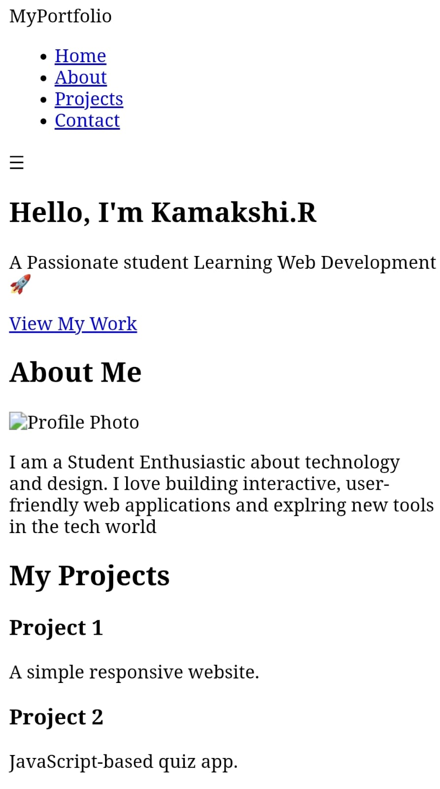
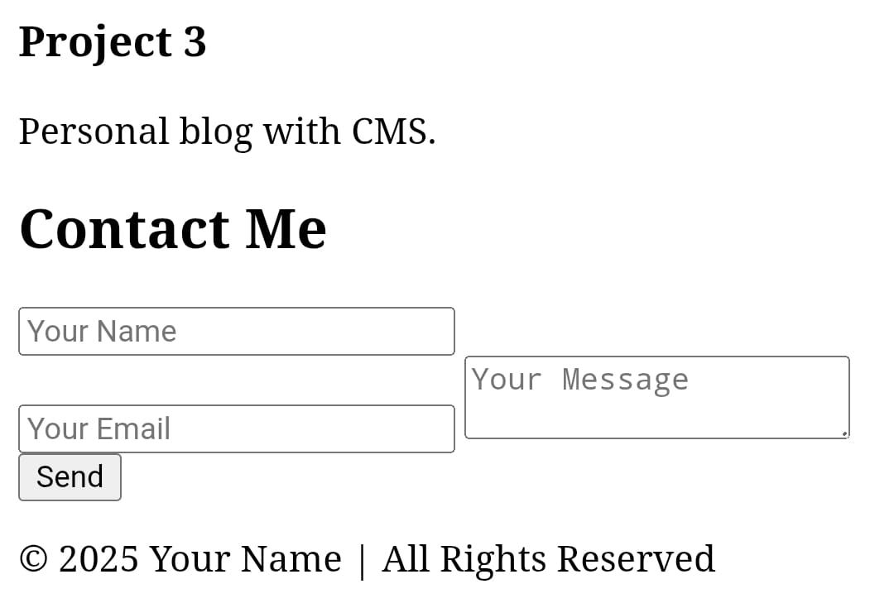

RESULTS AND SCREENSHOTS
3/21/2024 Annual Review
10

Slide 11
CONCLUSION
The student portfolio website is a powerful digital tool that effectively showcases a student's skills, projects, and personal journey in a professional and engaging manner. It provides a comprehensive online presence that helps the student stand out to potential employers, educators, and collaborators. By combining interactive features such as responsive navigation, project displays, and a contact form, the portfolio not only highlights technical abilities but also demonstrates creativity and digital literacy. This platform serves as a dynamic digital resume, allowing easy sharing and continuous updating of achievements. Overall, creating and maintaining this portfolio website is an important step in building a personal brand, enhancing employability, and fostering long-term professional growth in today’s competitive digital landscape
11

